Slide 1

A Tour of Several Free Tools for LabVIEW Programmers
Presentation Date: Wednesday, 06 December 2023
Event: Winter Midlands LabVIEW User Group (online event over Teams)

Slide 2




Presenter
Petru Tarabuta MEng MIET | Test System Engineer
Contact Details
Email: petru@robustosystems.com
Tel: 01452 452 165
Robusto Systems Ltd (UK)
www.robustosystems.com
Notes:
I am originally from Romania. I studied Electrical and Electronic Engineering at The University of Sheffield and have lived and worked in the UK ever since. I am helping customers through my company, Robusto Systems.
Contact Details
Petru Tarabuta MEng MIET CLA CTD CPI | Test System Engineer
Robusto Systems Ltd
petru@robustosystems.com
01452 452 165
www.robustosystems.com

Slide 3
Introduction
This presentation is a quick tour of several free tools that can be useful to us, LabVIEW programmers
Motivation:
It is useful to be aware of reliable, useful tools.
Some of the tools may be well-known, others less so.
Most of the following tools can be useful to programmers regardless of their programming language, and to knowledge workers in general.
I have been using some of the tools for a few years, others for only a few months.
I will describe my personal experience with the tools.
I’m not an expert in any of the tools. I’m a competent user of some, and a novice user of others.
Operating System disclaimer:
Some of the tools are applicable to Windows only.

Slide 4
Questions
I will share my screen for most of the presentation, to show the tools in action.
Please ask questions at any time
I will try to keep an eye on the Teams chat, but feel free to also use the microphone to ask questions

Slide 5
Activity
Throughout the presentation, please think of useful tools that might be similar, or an alternative, to the tool being presented, and please write these in the Teams chat.
At the end of the presentation, please write in the Teams chat any other useful tools you use. These can be free, or paid-for, if you feel they offer good value.
This way we can learn from each other in terms of what tools people find valuable.

Slide 6
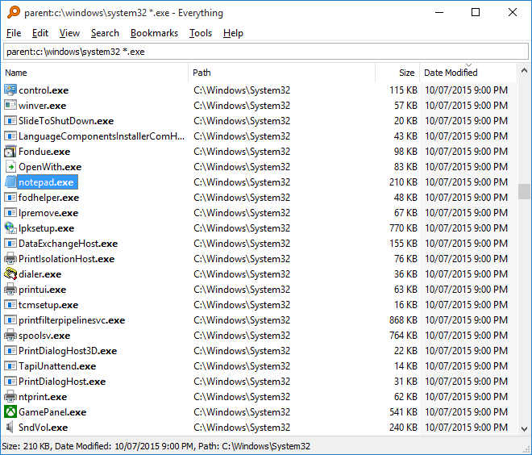
Search Everything
Notes:
https://www.voidtools.com/support/everything/
"Everything" is a filename search engine for Windows.
How is Everything different from other search engines
Small installation file.
Clean and simple user interface.
Quick file indexing.
Quick searching.
Quick startup.
Minimal resource usage.
Small database on disk.
Real-time updating.

Slide 7
Sysinternals Tools
The Sysinternals Tools are fantastic tools for monitoring and understanding the Windows OS, and applications that run on Windows.
More than 50 tools
The three most useful (in my opinion):
Process Explorer
Process Monitor
Autoruns
Notes:
The Sysinternals Tools are fantastic tools for monitoring and understanding behaviour of Windows apps.

Slide 8

Sysinternals Tools
There is a book that describes in detail the purpose of, and how to use each Sysinternals tool.
Notes:
The Sysinternals Tools are fantastic tools for monitoring and understanding behaviour of Windows apps.

Slide 9
Windows PowerToys Suite
PowerToys are a suite of tools for the Windows power-user
23 tools at present
Some of the most useful:
PowerRename
Image Resizer
Color Picker
Always On Top
Awake
Notes:
PowerToys are a suite of tools for the Windows power-user

Slide 10

Paint.NET

Slide 11
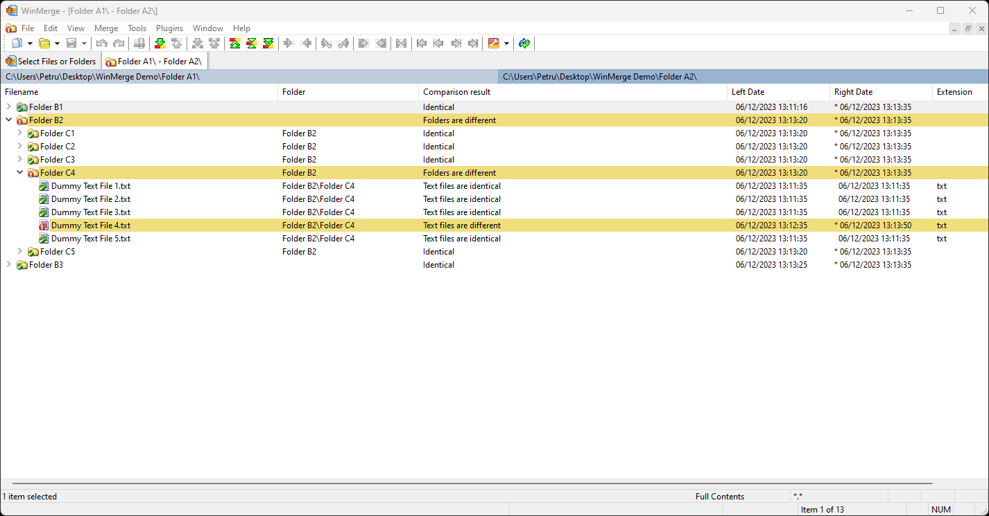
WinMerge

Slide 12
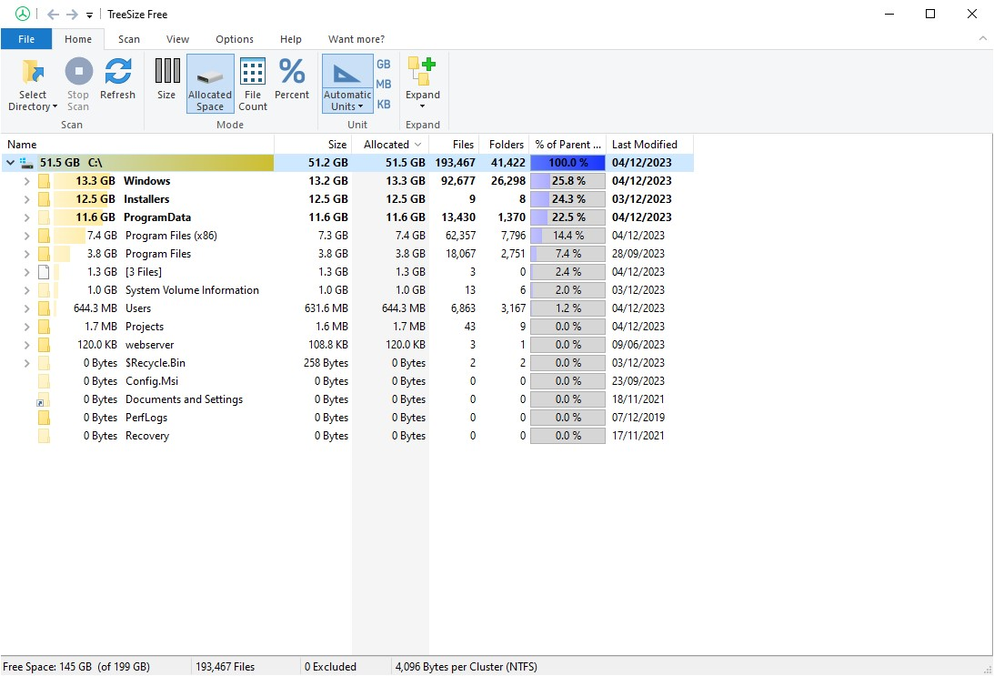
TreeSize (free version)

Slide 13
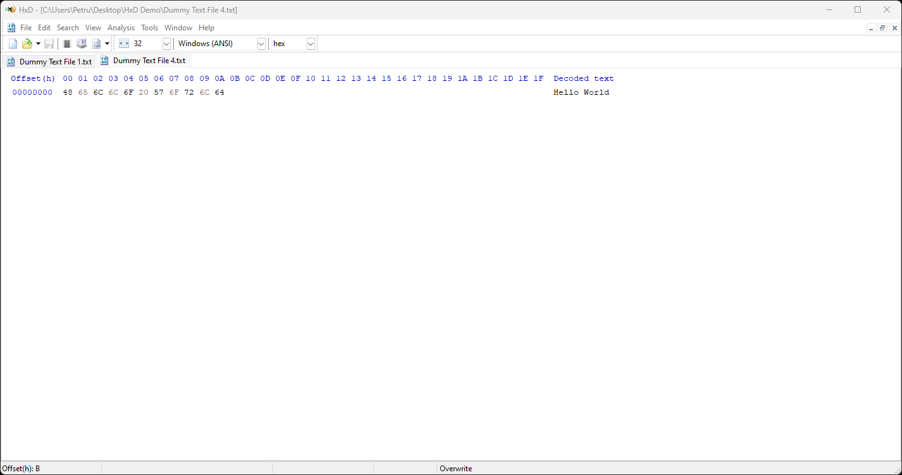
HxD
Notes:
HxD is a hex viewer
Another free alternative: VS Code hex plugin

Slide 14
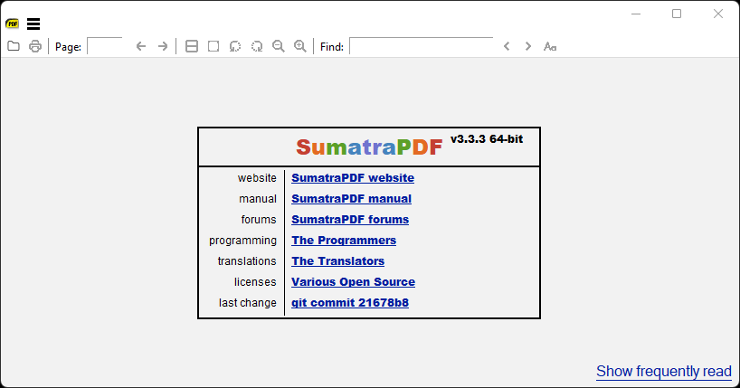
SumatraPDF
Free PDF reader
Cleaner GUI than the ubiquitous Adobe Reader
Loads documents more quickly

Slide 15
Greenshot
Free tool for taking screenshots
Better than the Windows Snipping Tool in some ways
The latest version of Windows Snipping Tool is excellent too, especially in up-to-date version of Windows 11.

Slide 16
Tools Summary
Tool | URL | Notes
Search Everything | https://www.voidtools.com/
Sysinternals Tools Process Explorer Process Monitor Autoruns | https://learn.microsoft.com/en-us/sysinternals/ | Can be installed from Microsoft Store too.
Windows PowerToys suite PowerRename Image Resizer Color Picker Always On Top Awake | https://learn.microsoft.com/en-us/windows/powertoys/ | Can be installed from Microsoft Store too.
Paint.NET | https://www.getpaint.net/download.html
WinMerge | https://winmerge.org/downloads/?lang=en
TreeSize | https://www.jam-software.com/treesize
HxD hex viewer | https://mh-nexus.de/en/hxd/
Sumatra PDF | https://www.sumatrapdfreader.org/download-free-pdf-viewer
Greenshot | https://getgreenshot.org/downloads/

Slide 17
Thank you!
Are there any questions?

